Slide 1
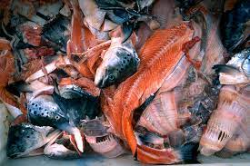
Fish Waste Utilization: A Multi Stage Plan with Potentials and Economics
1

Slide 2
The Plan
1/ What is the availability of fish by-products ?
2/ The present uses of the by-products
3/ The potential uses of the by-products
4/ Some basic economics to consider for food fishery by-products uses
5/ Elaborating a strategy
2

Slide 3
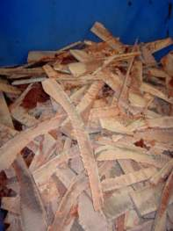
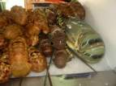
1/ What is the availability of fish by-products ?
Doing an industry survey in the fisheries sector
and the seafood processing industry
What ?
Fresh finfish :
Heading, gutting, skinning, filleting, cutting …. On shore (off-shore)
Main species, main by-products and yields of by-products
Fresh shellfish
Cooking, peeling, extracting flesh of crustacean; shucking bivalves
Main species, main by-products and yields of by-products
Fish canneries
By-products generated from raw fish or from pre-cooked fish
Fish smoking factories
Heading, gutting, skinning, filleting on raw material
Main species, main by-products and yields of by-products
Fish-based frozen products (pieces or dishes)
Main species, main by-products and yields of by-products
Other fish processing units
Main species, main by-products and yields of by-products
C.
3

Slide 4
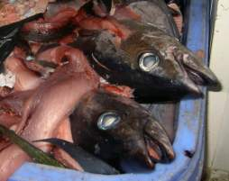
1/ What is the availability of fish by-products ? (2)
When ? Seasonality for the main species
Who ? Main companies by type of activity
Where ?
Geographical localization of fish processing plants
Concentration vs atomization ?
C.
4

Slide 5
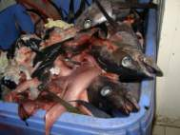
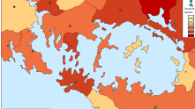
1/ What is the availability of fish by-products ? Results
Estimating the overall quantity, the main origins and types, the variation in availability
Mathematically, the volume of by-products from a food fishery is determined by the harvest volume and 2 yield percentages:
Food fish harvest volume
x Percent of food fish volume for which byproducts are available
= Food fishery volume for which byproducts are available
x Byproducts yield
= Byproducts volume
Understanding the ability and constraints to sort by-products according to future uses
Mapping the availability of by-products
Understanding the present routes of byproducts
5

Slide 6
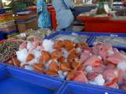
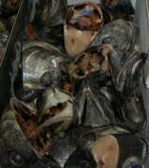
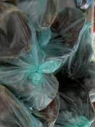
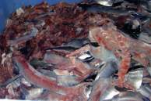
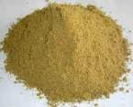
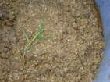
2/ The present uses of the by-products
Food on local market or export ➔ income
Feed on local market ➔ income or 0
Processing into : fish meal & fish oil, others ➔ income
Disposal on land or at sea (= wastes) ➔ cost
C.
6

Slide 7
3/ The potential uses of by-products
Products and technologies : options and hierarchy ➔ cf speech of Jean-Pascal BERGE
Markets: local or export, demand and competition, prices of final products, costs for storage and transport
Legislation:
In producing country: food hygiene legislation, waste legislation (storage, transport, disposal), by-products raw materials and permitted treatments
In targeted market countries for the different final products: food, feed, agriculture fertilizers, nutraceutical and pharmaceutical products,…
Environmental impacts: solid or liquid waste, odour, noise, transport, airborne pollution, water pollution, energy use, water use, space requirements
C.
7

Slide 8
4/ Some basic economics to consider for food fishery byproducts uses
Profit maximization for primary food products drives fundamental economic choices for food fish processors:
Species processed
Timing of production
Locations of facilities
Scale of facilities
Product mix
Product yields
Optimal economic choices for food fish production are not necessarily optimal for by-products production and utilization
8

Slide 9
4/ Some basic economics to consider for food fishery byproducts uses (2)
The scale needed for profitable processing of byproducts is likely to be higher than for food fish production.
Larger scale production is needed because of:
Higher relative capital costs
Lower relative unit values
Lower yield from harvest volume
Higher volume requirements of buyers
For food fish processors, using the food fish byproducts may be unprofitable:
If the scale of production is too low
If production is too seasonal
9

Slide 10
4/ Some basic economics to consider (3)
Selected factors which affect the likelihood of making alternative products with byproducts from a food fishery
C. Mariojouls, Nouméa June 11th 2012
10

Slide 11
5/ Elaborating a strategy
By-products and wastes initial survey
Concerned actors: strategies and organization
R&D
Government policies and subsidies
Projects planning and comparison: timescale for management options, scale of unit, costs (capital, running, per T) and returns, profitability
A strategy for several years and terms
11

